Slide 1
Versioning and Coupons
Module 6 · Video 5
Management 405
Prof. Nico Voigtländer · UCLA Anderson

Slide 2
Module 6 · Video 5 · Agenda
Outline of Module 6
1
Simple vs. Complex Pricing
Video 2
2
Direct Price Discrimination
Videos 3+4
2a
Perfect Price Discrimination (First Degree)
Video 3
2b
Segment Pricing (Third Degree)
Video 4
3
Indirect Price Discrimination (Second Degree)
Versioning and coupons let customers sort themselves
Video 5
4
Advanced Pricing Strategies
Videos 6–8
4a
Flat Fee Pricing
Video 6
4b
Two-Part Tariff
Video 7
4c
Block Pricing
Video 8
5
Summary of Pricing Strategies
Video 9
Management 405 · Module 6 · Complex Pricing and Advanced Pricing Strategies
2
Notes:
Now the case where the firm cannot tell customers apart, so it makes them sort themselves.

Slide 3
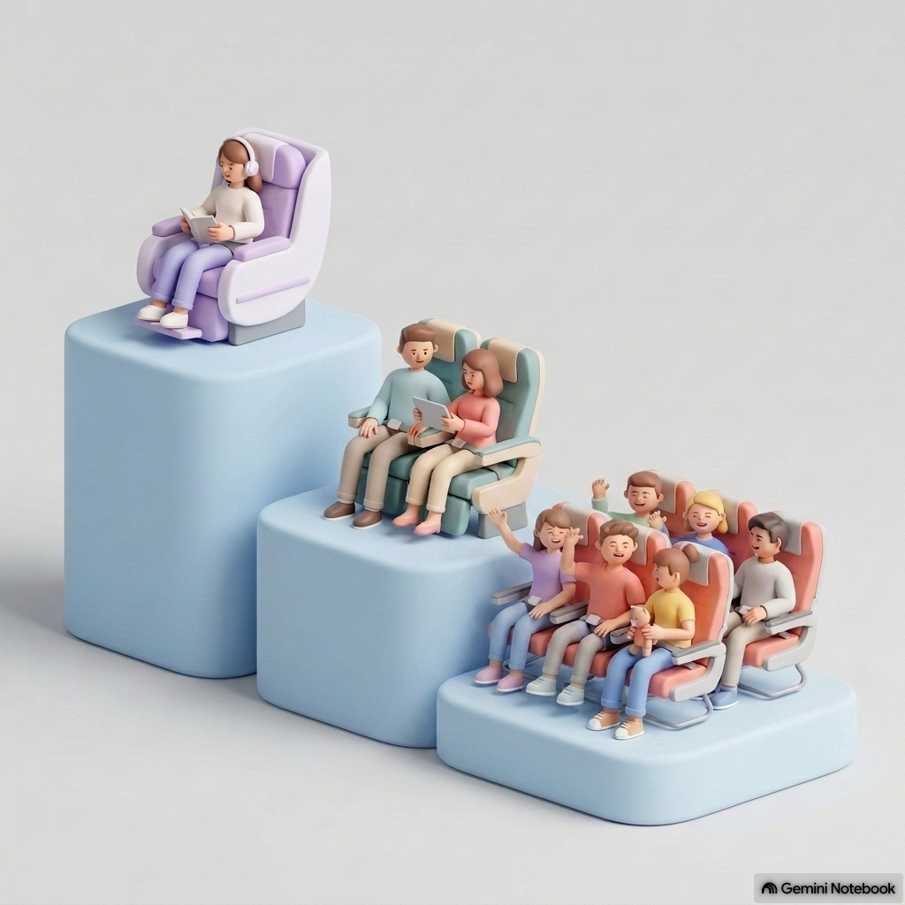
Module 6 · Video 5 · Indirect Price Discrimination (Second Degree)
Second Degree Price Discrimination: Versioning
Indirect price discrimination
Charge a different price for different versions of the product
Conditions:
  Firm has market power
  Consumer groups with different willingness to pay for the product category (e.g., airplane cabins)
  Firm cannot directly identify the different groups of consumers
Management 405 · Module 6 · Complex Pricing and Advanced Pricing Strategies
3
Notes:
Second-degree, or indirect, pricing is what you do when you cannot identify the groups. Instead of pricing the customer, you price versions of the product and let people choose. The firm still needs market power and customers who differ; what it no longer needs is any way of telling who is who.

Slide 4
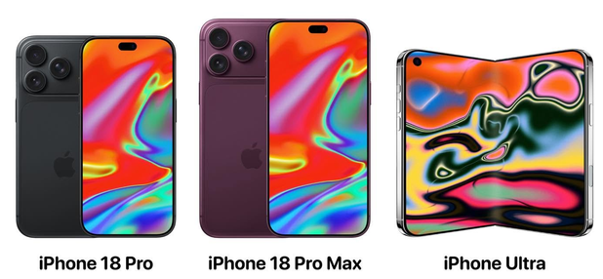
Module 6 · Video 5 · Indirect Price Discrimination (Second Degree)
Versioning
P / MPV
P₁
Version
1
P₂
Version
2
P₃
Create different “versions” of your product
Design them so that customers with different MPV “self-select” into the version you intend for them
Version
3
P₄
Version
4
P₅
Version
5
D
Q
Management 405 · Module 6 · Complex Pricing and Advanced Pricing Strategies
4
Notes:
An example of Second Degree Price Discrimination: Versioning
We will go in greater depth into one form of second degree price discrimination which is versioning. Versioning is incentive compatible and accomplishes everything that price discrimination accomplishes. Consumers who buy at a high price do so willingly. The key to understand this is that the version priced at a premium has to have features that generate some value to the consumer, but the cost differential to the company is minor relative to the price differential (otherwise there is no real discrimination on price if the surplus captured is the same across segments).
The perfect example is Microsoft: offers Windows Professional and Windows Home Edition. Windows Pro has more features than Home edition but they are otherwise close substitutes. The marginal cost of producing each is identical (and approximately zero) – in fact it may cost the company something to actually differentiate the products. Sometimes it costs nothing to make something better but you don’t want to do it: why doesn’t Microsoft offer the full version of Windows to all their customers since the MC of doing so is zero? Because they would then join the markets, and forego the benefits of price discrimination. You add features to the price insensitive segment so you can charge them more.

Slide 5

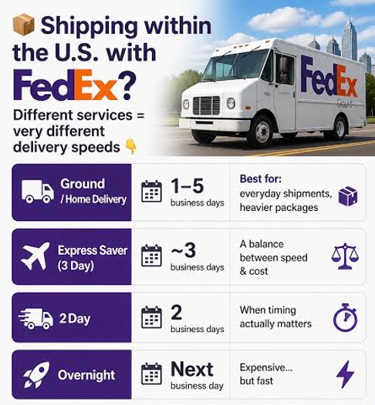
Module 6 · Video 5 · Indirect Price Discrimination (Second Degree)
Examples for Versioning
Internet service: higher speed at a higher price
FedEx/UPS: ground vs. same-day delivery
Airlines: business / premium economy / economy
Important note on versioning: keep the low-quality option inferior enough to prevent premium customers from being tempted
  This ensures “incentive-compatibility”
  So you don’t need to worry about resales
Management 405 · Module 6 · Complex Pricing and Advanced Pricing Strategies
5
Notes:
The pattern is everywhere once you look: internet speed tiers, ground versus overnight shipping, the three cabins on an aircraft. The design rule is the one at the bottom: the cheap version has to be genuinely worse, or your high-value customers will happily take it. That is what incentive compatibility means here, and it is why airlines make basic economy irritating on purpose.

Slide 6
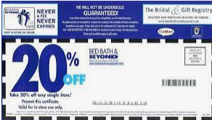
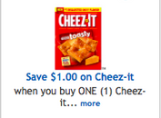
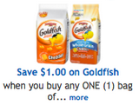
Module 6 · Video 5 · Indirect Price Discrimination (Second Degree)
Second-Degree Price Discrimination: Coupons
Clipping a coupon costs time, and price-sensitive customers care less about time
So the discount reaches exactly the customers who would not have paid full price
Coupons ensure incentive-compatibility
Management 405 · Module 6 · Complex Pricing and Advanced Pricing Strategies
6
Notes:
Checkout stand coupons: Nobody wants to spend money unnecessarily, but it takes time to sort through the coupons. Those who have nothing else to do on a Sunday morning, i.e. those with a low opportunity cost of time, who are price sensitive, will take the time to cut the coupons. This is an ingenious scheme to charge higher price to the low elasticity customers to capture more consumer surplus.

